Slide 1
Secrets of the JTS Topology Suite
Martin Davis
Refractions Research Inc.

Slide 2
Overview of presentation
Survey of JTS functions and components
Tips for using JTS as an engine for processing Geometry
Tips for using JTS components and APIs for spatial algorithm development
Future Enhancements

Slide 3
Overview of JTS
Java API for modeling & manipulating planar linear vector geometry
  License: LGPL
Development History
  Version 1.0 - May 2001
  Version 1.8 - December 2006
  Version 1.9 – Q4 2007
Clients:
  JUMP, GeoTools (uDig, GeoServer), eXist, etc.
  (as GEOS) PostGIS, FME, OGR, MapServer, MapGuide Open Source, etc.
  (as NTS) monoGIS, SharpMap, etc?

Slide 4
JTS as a Geometry Engine
Geometry types
    Point, MultiPoint, LineString, MultiLineString, Polygon, MultiPolygon, GeometryCollection
Geometry methods
    Spatial Predicates, relate()
    Overlay ops, buffer(), convexHull()
    Metrics: area(), length()
    distance(), withinDistance()
Geometry Processing
    Line Merging
    Noding & Polygonization
    Simplification
    Linear Referencing

Slide 5
Geometry Operation Classes
Most non-trivial Geometry methods are implemented as classes
Often classes provides extra functionality
Examples:
  DistanceOp can return two closest points
  IsSimpleOp can return location of non-simplicity
  IsValid gives option to check for SDE-style polygon topology
  RelateOp allows BoundaryNodeRule to be specified

Slide 6
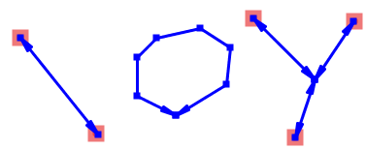
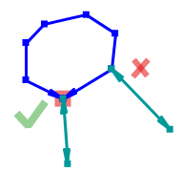
Spatial Relationships & Boundary Node Rules
How boundary points of linear geometries are determined
  OGC-SFS specifies “Mod-2” Rule
Other rules sometimes useful
  All Endpoints
    Ex: Do roads touch only at nodes?
  Monovalent Endpoints
  Multivalent Endpoints
RelateOp class allows specifying rule to use

Slide 7
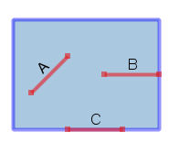
Additional Spatial Predicates
OGC-SFS spatial predicates have some subtle behaviour
contains() : Polygons do not “contain” their boundary!
  A & B : contains()==true
  C : contains()==false
JTS provides covers() and coveredBy() , which treat boundary and interior identically
Side benefit – easier to optimize
  e.g. <rectangle>.covers()

Slide 8
Optimized Spatial Predicates
Spatial query / join is common use pattern
  i.e. repeated predicate operation on same geometry
PreparedGeometry improves performance
  Uses caching, algorithm optimizations
  Over 100x faster in some cases!
Currently provides most important predicates
  intersects, contains, covers
New in JTS 1.9
PreparedGeometry targetPrep
= PreparedGeometryFactory.prepare(targetGeom);
for ( <geometries to test> ) {
Geometry test = ...
if (targetPrep.intersects(test)) {
...

Slide 9
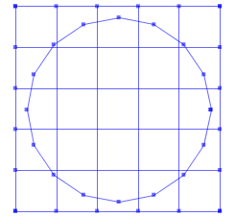
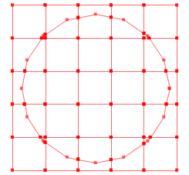
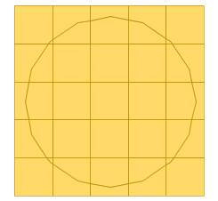
LineString Noding, Polygonization
Problem: Node & Dissolve a set of LineStrings, then Polygonize

Slide 10
LineString Noding, Polygonization cont’d
Trick: to node & dissolve, combine LineStrings into a MultiLineString, then union them with a Point from one of the lines
Noded lines can be polygonized using the Polygonizer class
New in JTS 1.9: Geometry.union()
Collection lines = ...
Geometry mls = geomFactory.buildGeometry(lines);
Point mlsPt = geomFactory.createPoint(mls.getCoordinate());
Geometry nodedLines = mls.union(pt);

Slide 11
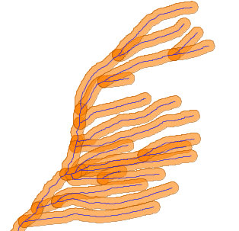
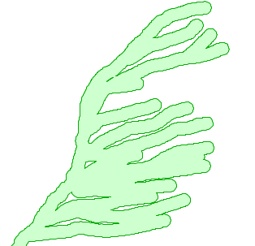
Polygon Union using buffer(0)
Merging a large set of Polygons using repeated polyUnion.union(poly) can be slow
Trick: combine Polygons into a GeometryCollection, then compute gc.buffer(0.0)
Warning - doesn’t work for non-polygonal features!
New in JTS 1.9: Geometry.union()

Slide 12
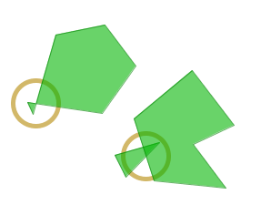
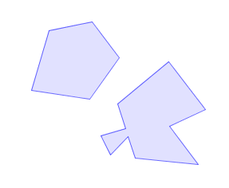
Polygon Cleaning using buffer(0)
Polygons from external data sources can be invalid because of self-intersections or overlaps
Trick: computing buffer(0.0) removes pinch-offs, merges overlapping polygons
It would be nice to have more control over cleaning behaviour!
Future: PolygonRectifier

Slide 13
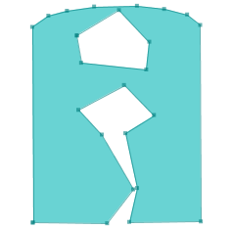

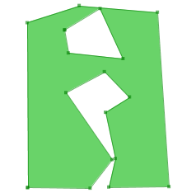
Geometry Simplification
Two types
  DouglasPeuckerSimplifier
    standard Douglas-Peucker
    Faster, but does not preserve topology
  TopologyPreservingSimplifier
    Slower, but preserves topology (lines will not cross, holes are preserved)
Not Geometry methods – use classes directly

Slide 14
JTS as an algorithm library
JTS contains many algorithms and components for building spatial algorithms & processes
  Fast Point-in-Polygon
  Robust Line-Point orientation, Ring orientation
  Line segment intersection detection & computation
  Spatial indexes (and MonotoneChain)
  Indexed Noding & Intersection detection for line arrangements
  PlanarGraph package
  Primitive Geometric objects & methods
    LineSegment, Triangle, Angle

Slide 15
Fast Point-In-Polygon
Common use case is repeated P-I-P queries against a fixed polygon
This case can be optimized by using spatial indexing
Options:
  As component: IndexedPointInAreaLocator
    Result in {INTERIOR, BOUNDARY, EXTERIOR}
  Also PreparedGeometry.intersects(), contains()
Uses incremental RayCrossingCounter – easy to use over custom Ring data structures

Slide 16
Spatial Indexes
Several types of spatial index available
  2-D: QuadTree, STRtree
  1-D: Bintree, SortedPackedIntervalRTree
Used in many internal JTS operations to improve performance
  Line noding
  Line segment intersection detection
  Point-in-polygon
Often useful for improving performance of “naive” spatial algorithms
  In theory takes O(n²) into O(n log n) !

Slide 17
Spatial Indexes – STRtree VS QuadTree
STRtree
  Packed R-Tree
  Cannot be modified once built (no insert or delete)
  Fastest performance
QuadTree
  Slower performance (but still good!)
  Supports insert & delete
  Useful for “online” algorithms

Slide 18
Future Enhancements
Polygon Fixing/Cleaning
PreparedGeometry.intersection()
Rectangle clipping (intersection)
Buffer enhancements: variable-width, single-sided, offset lines
Geometry Smoothing, Densification
Measures support for Linear Referencing
Geometry.cut(Geometry)
Topology API
Interface-based Geometry model
  Easier to use JTS over other geometry implementations
  Coordinate interface too!

Slide 19
Downloads & Information
Download JTS
http://sourceforge.net/projects/jts-topo-suite
JTS Mailing List
http://lists.jump-project.org/mailman/listinfo/jts-devel

